Slide 1

Encoder Decoder

Slide 2
INTRODUCTION
In an era dominated by digital communication, the Encoder and Decoder application emerges as a crucial tool facilitating data transformation. This application plays a pivotal role in encoding and decoding messages, bridging the gaps in our digital interactions.

Slide 3


THE UTILISATION OF ENCODER/DECODER
Versatility
Encoder and Decoder exhibit remarkable adaptability, accommodating diverse encoding and decoding needs seamlessly
Dynamic Communication Enhancement
Serving as a dynamic communication enabler, the application plays a pivotal role in transforming and harmonizing data

Slide 4
TECHOLOGIES USED

Slide 5
Features of Encoder/Decoder
UTF
CAESER
BASE64
BINARY
Ensuring internationalization and multilingual support
Offering a customizable encryption technique.
Facilitating secure data transmission
Representing text characters in binary form.

Slide 6
GLOBAL IMPACT
Enhanced Communication:
In the global landscape, efficient and secure communication is paramount. The Encoder and Decoder application contributes significantly to this by enabling seamless encoding and decoding processes. International collaborations, data exchange, and cross-cultural communication are facilitated, fostering a more connected world.
Connectivity:
Our application plays a pivotal role in enhancing global connectivity. From trade and commerce to cultural exchange, encoding and decoding are the building blocks of effective communication, breaking down barriers and fostering connections.

Slide 7

NECESSAITY of ENCODER/DECODER
1ST Data Security
2ND Interoperability
Ensuring the security of data during transmission is a top priority. The Encoder and Decoder application addresses this necessity by providing robust encoding techniques. In scenarios where privacy and protection are critical, encoding becomes indispensable.
The necessity of decoding comes to the forefront when we consider interoperability between systems. The application tackles challenges in encoding and decoding, ensuring seamless communication between diverse platforms and technologies.

Slide 8
FUTURE SCOPE
ADVANCE ALGORITH
USER INTERFACE UPGRADES
Looking ahead, we envision incorporating advanced encoding and decoding algorithms. The application will evolve to meet emerging data transformation needs, potentially exploring machine learning-based approaches for enhanced efficiency.
User experience is at the forefront of our priorities. We plan to enhance the user interface, making it more intuitive and user-friendly. Additional features will be integrated based on valuable user feedback, ensuring the application's continuous improvement

Slide 9

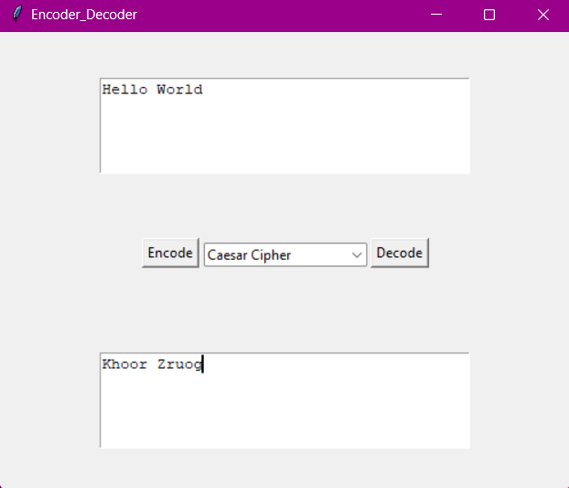

DESKTOP MOCKUP
Download: agrimk.com/encoder_decoder

Slide 10


OUR TEAM
Archi
Tanwar
02318002721
Agrim
Kulshreshtha
01318002721
Gorish
Gupta
02018002721

Slide 11
THANKS!

